Slide 1
Mario game rules

Slide 2
Watch the video here
https://www.youtube.com/watch?v=rLl9XBg7wSs&ab_channel=Pii89

Slide 3
Other rules
MUSHROOM: make bigger
If I hit with Mario = I disappear.
FLOWER: give fire
If I hit with Mario = I disappear.
STAR: give invulnerable
If I hit with Mario = I disappear.
CHECKPOINT:
If I hit with Mario = i change color to blue.
CAMERA:
Camera always follow Mario
ENEMY
If Mario hit me on the top = I will die.
If Mario hit me but Mario has the STAR = I will die.

Slide 4
MARIO rules
If I hit the star, I become invincible for XXX seconds
If I hit the mushroom,
I become XXX scale
If I hit an enemy:
If I am big, I become small
If I am small:
minus 1 life.
If I have 0 life, I die
If I am invincible, enemy die
If I hit green mushroom, I get 1 life
If I hit checkpoint, save the location of the checkpoint
If I die, restart from last checkpoint
on start of game:
Give mario 2 life
Save start as checkpoint

Slide 5
Until 10:30 everybody work
10:30 we all come back to the main room.
Every mini team shows his result.

Slide 6
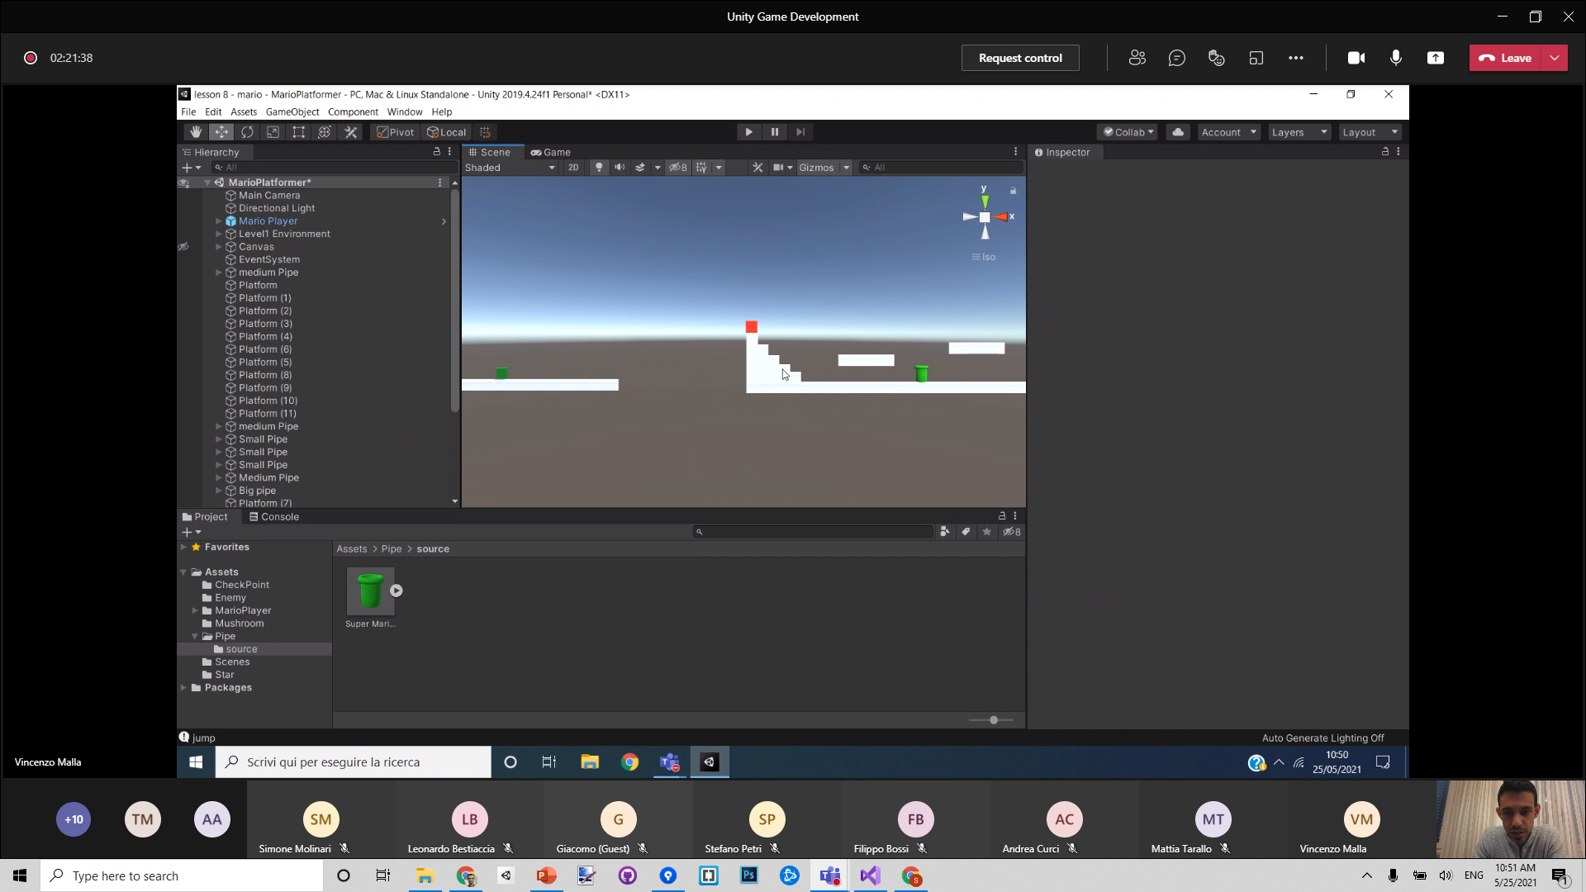

Slide 7
mario
star
enemy
Mario
star
star
enemy
Mario star
enemy

Slide 8
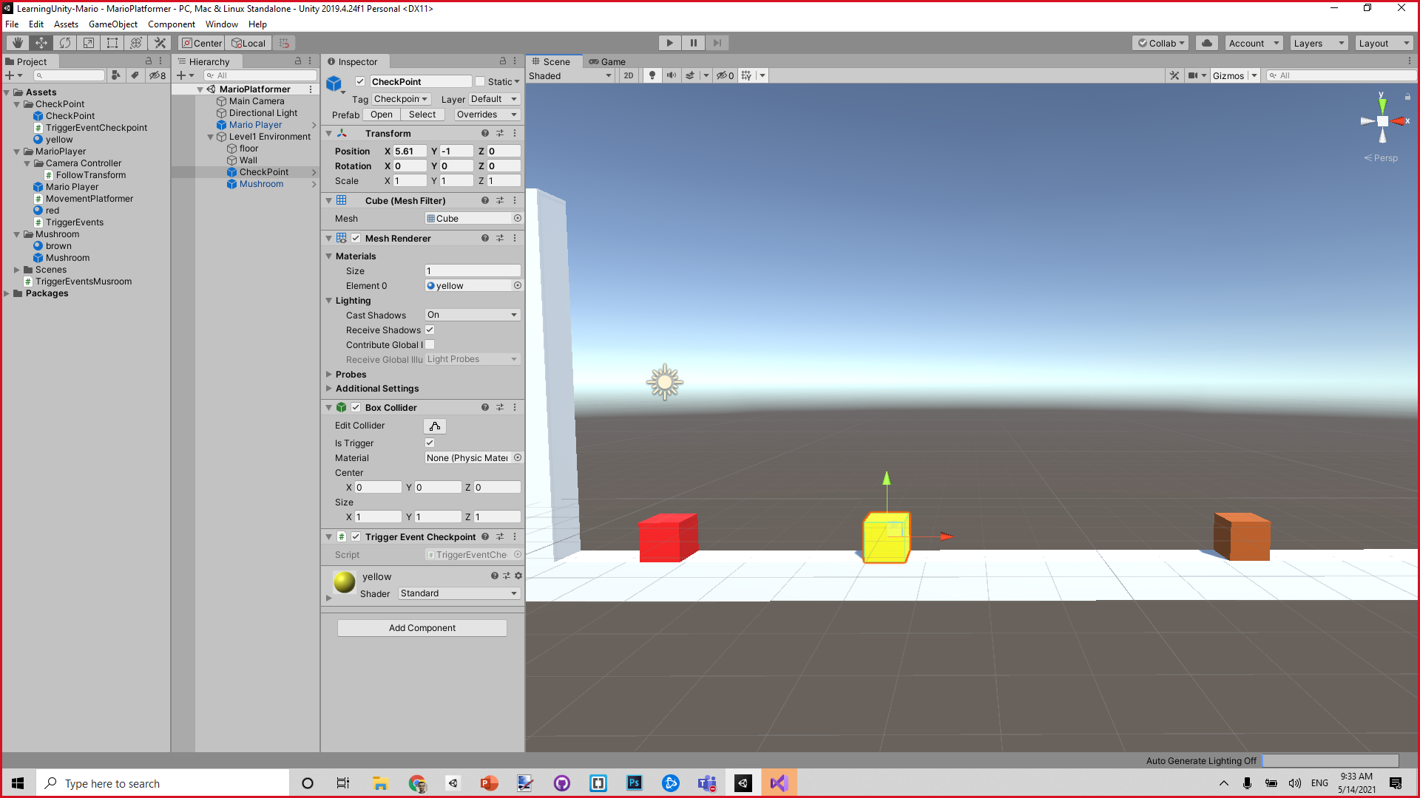
checkpoint
mushroom

Slide 9
How to start developing the game
Make the avatar move
OnKey RIGHT , go right
OnKey LEFT, …
OnKeyDown Press UP, jump (physics or animation...).

Slide 10
Plan
Insert 3d model inside the cube (Filippo)
All the big features:
Mushroom, star, enemy
Complete game cycle
Menu system
Level design (make it fun).
From Starting point to finish point
Change rules:
Health, damage,
Fire
Killing stuff
Animations
Sound effects
Visual effects

Slide 11
Menu system
Welcome to MARIO 2021
If click START GAME button:
Close start screen
START GAME

Slide 12
The actual game……

Slide 13
Ohhhhh, too bad…
game over
If click RESTART button
Remove restart screen
Restart level()
RETRY

Slide 14
Invisible colliders to activate

Slide 15
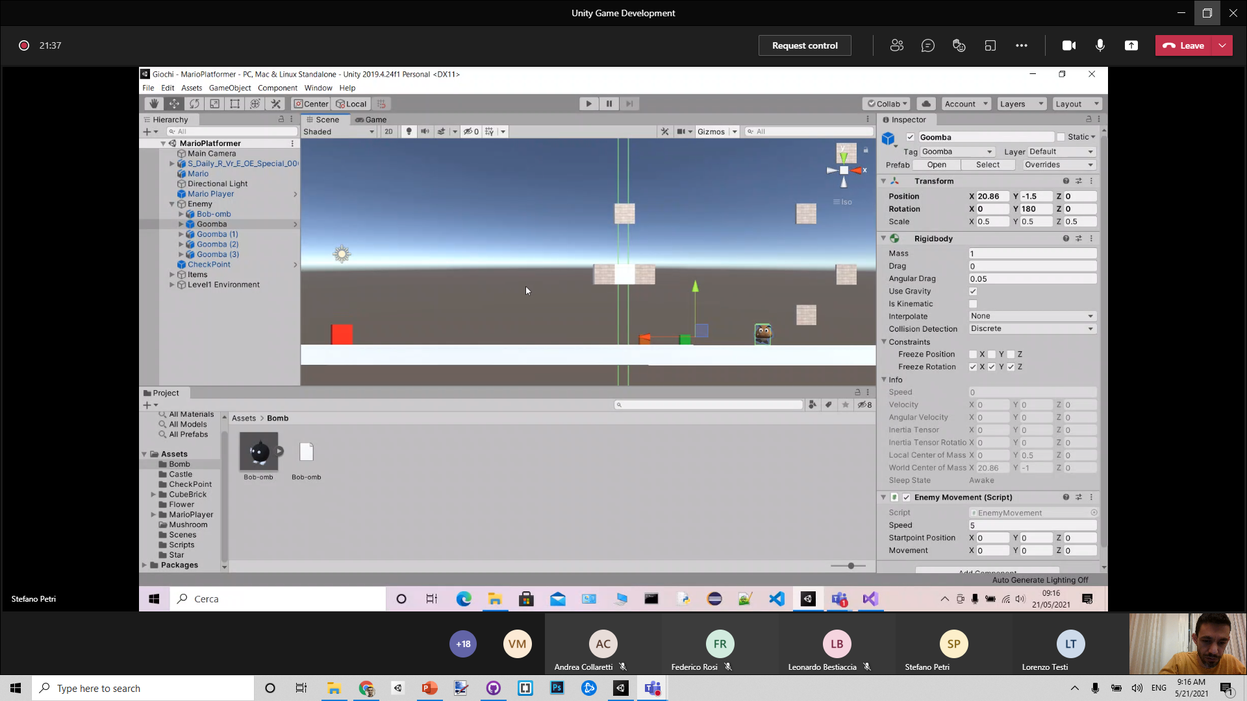

Slide 16
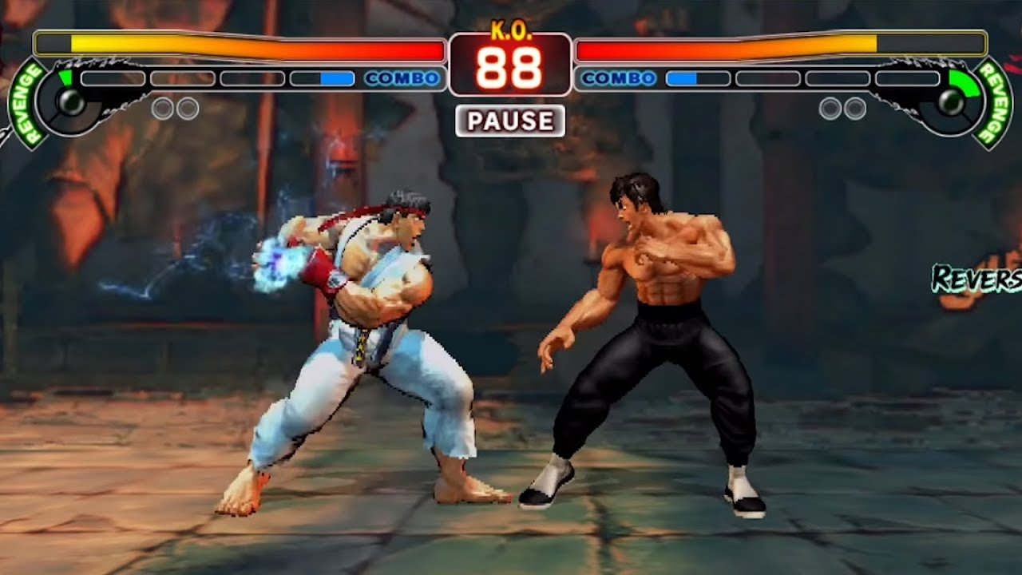

Slide 17
Enemy structure
Game object : Enemy
3d cube
Game object: Head
Top collider
Game object: 3d model of goomba
Body collider

